Slide 1


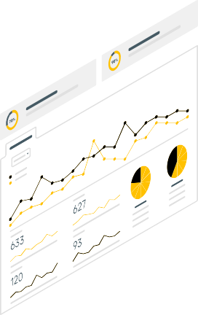



Silicon Rush Proposal
idkWhatWe’reDoing
M Aswartha Reddy, 1RV21CS076,RVCE
Shishira M Iyar, 1RV21CS154,RVCE
D K Bharath Reddy, 1RV21CS032,RVCE
Pulkit Dhamija, 1RV21CS118,RVCE

Slide 2
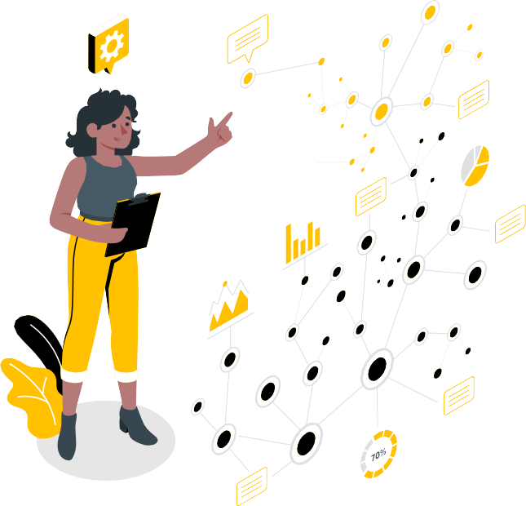

Problem Statement
Smart Home Infrastructure

Slide 3
Problem Statement
Many people who either live alone or in isolated locations, pose the threat of home thefts / intruders.
They have no way to know if a door has been opened when no one is home
The elderly or the disabled often depend on others for help, such as turning ON/OFF lights, fans especially when they are about to sleep or when they wake up in the middle of the night.
We can enhance our quality-of-life by automating repetitive tasks be it turning ON the geyser in the morning or mosquito repellent devices like All Out or Good Knight at a pre-set schedule.

Slide 4
Solution
01 | 02 | 03
Security | Safety | Quality of Life Enhancements
04 | 05 | 06
Accessibility | Easy to use and User Friendly | Easily Scalable

Slide 5
Solution Appendix
1. Security
Get notified on the app if an unknown person is detected around the home.
Watch a live stream from camera on a browser or the app.
Get emails of video from camera if any motion is detected.
Get on notified on the app if door is opened.
Open CV recognizes faces and opens the door
2. Safety
Get notified on the app if smoke or gas is detected.
Turn ON light in the night when motion is detected. This is helpful especially for the elderly when the wakeup during the night.
Remotely lock and unlock the door from the app. This allows keyless entry, thus limiting the spread of the deadly Coronavirus.
This keyless entry can be used to remotely open doors so that delivery agents can drop packages safely and securely even when the user isn’t home.

Slide 6
Solution Appendix
3. Quality of Life Enhancements
Occupancy awareness can be used to turn ON/OFF lights automatically depending on whether the user is home or not. This helps save a lot of electricity.
Control appliances remotely from the app.
Touch switches to control appliances without the app.
Set schedules to automatically turn ON/OFF appliances. E.g. Turning ON/OFF geysers in the morning, so the user has hot water ready to use as soon as they wakeup.
Accessibility
All home appliances can be controlled from a mobile application.
Low cost and hence accessible to all fields of society.

Slide 7
Solution Appendix
5. User Friendly
Easy to use for people of all ages.
Voice button allows them to control the appliances by voice commands.
Easy to navigate and learn about the working of the app even for uneducated people.
6. Easily Scalable
Can be customized as per the user’s requirements.
Appliances can be added or removed as and when required.

Slide 8
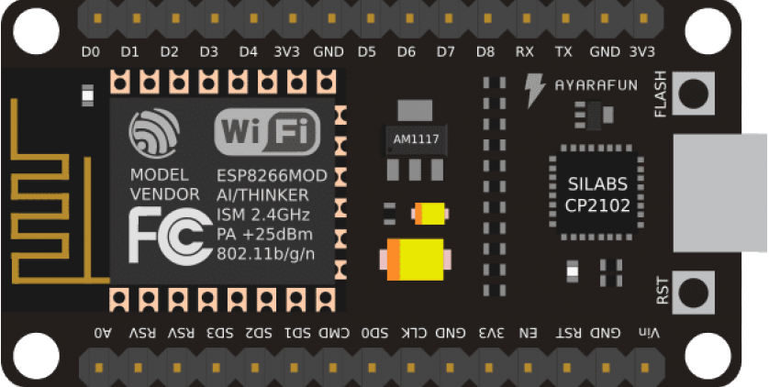
How our Solution Works
MAC Address Detection
These days almost everyone carries a smartphone with them.
These smartphones constantly emit Wi-Fi packets to look for already known access points.
These packets contain a source and destination MAC address.
We can look at the source MAC address to identify the smartphone and hence the person.

Slide 9
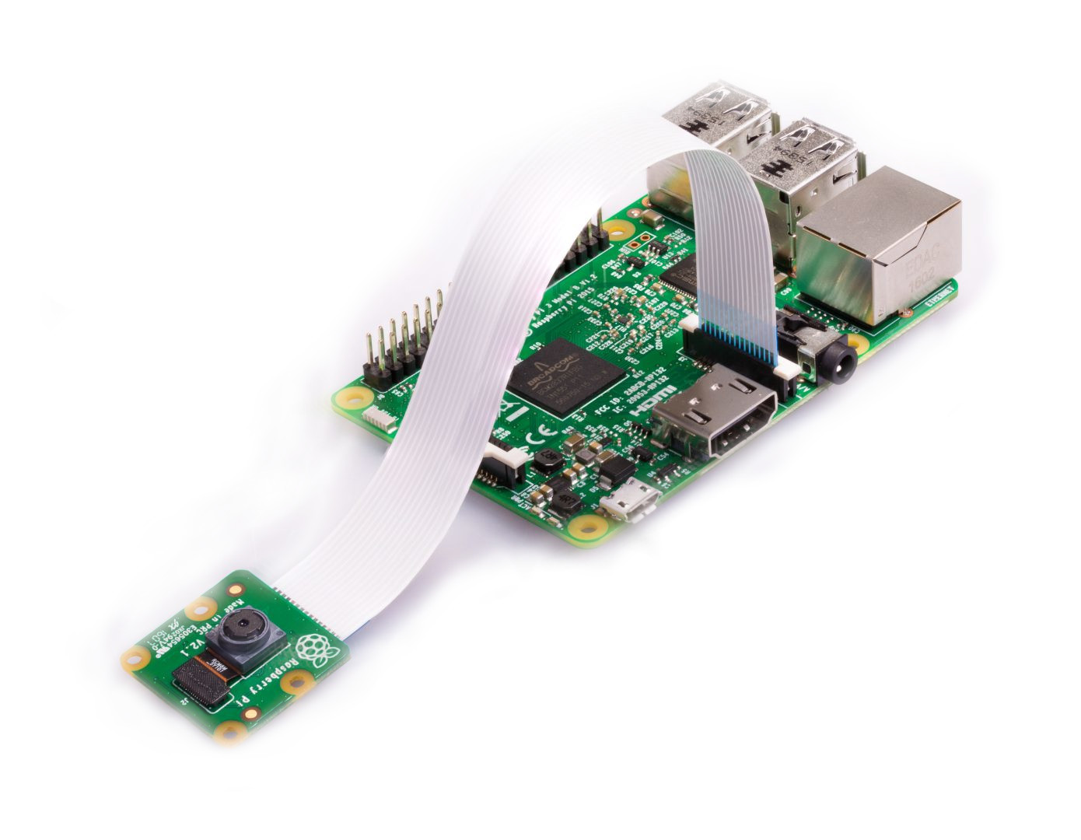
How our Solution Works
2. Security Camera
To local web server in MJPEG format
Can be viewed on a browser or the app.
If any motion is detected, it is recorded, saved locally and then, a copy is emailed.
Open CV to detect recognized faces and automatically open the door, alert on the app if face is unrecognizable.

Slide 10
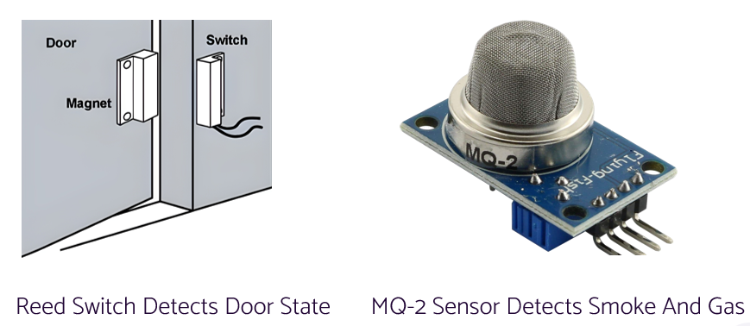
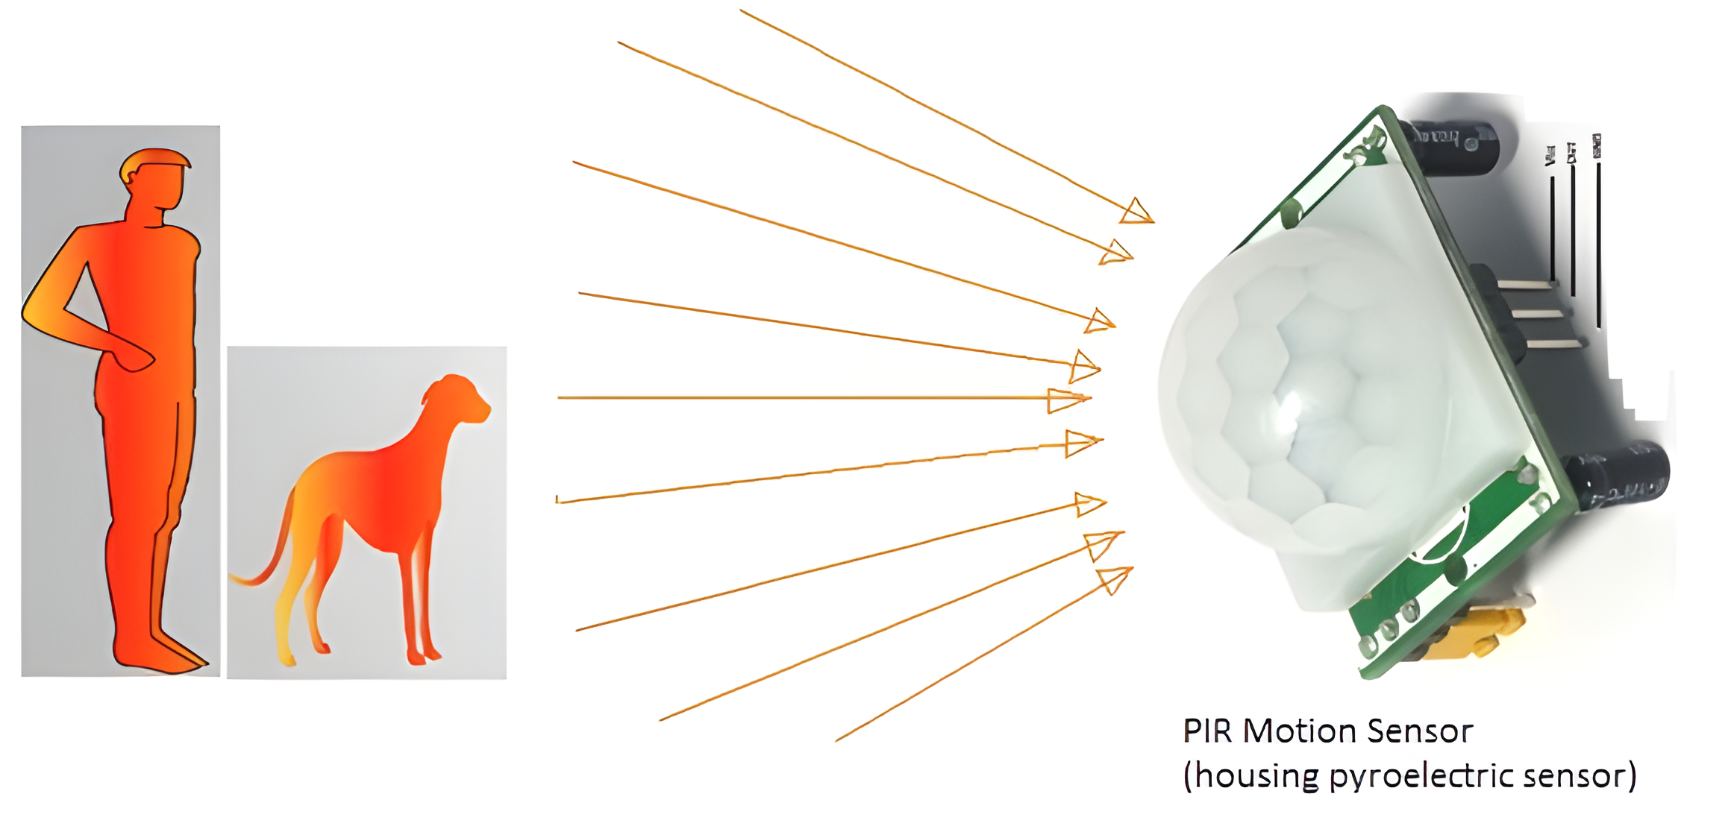

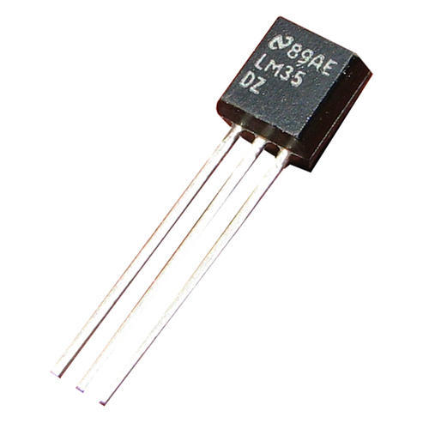

How our Solution Works
3. Sensors

Slide 11

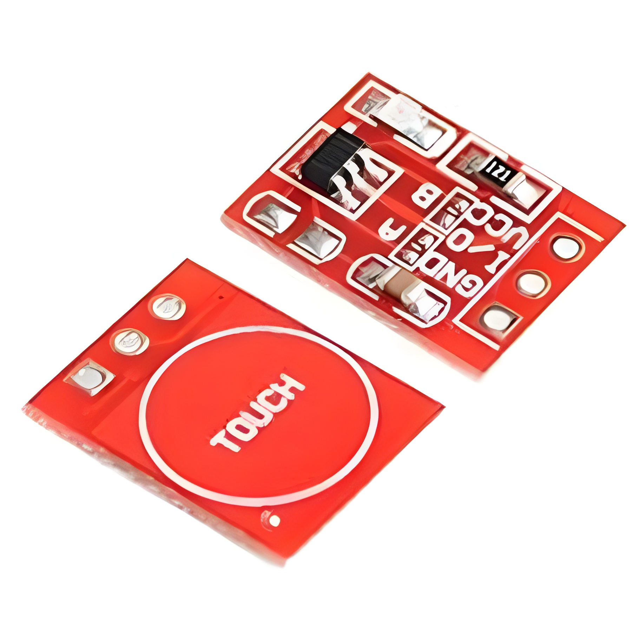


How our Solution Works
4. Touch Switch and Door Lock

Slide 12
Requirements
Software stack
Hardware
Kotlin for Android Studio
Arduino IDE
Firebase
Python
Motion Software
Sony Spresense
Node-MCU (ESP-8266)
ESP-32
Raspberry Pi 3 B+
Raspberry Pi Camera
TTP-223 Touch Switches
Reed Switch
MQ-02 Gas Sensor
Solenoid Lock
PIR Sensor
Jumper Wires
Breadboard
5V / 12V Power Supply

Slide 13
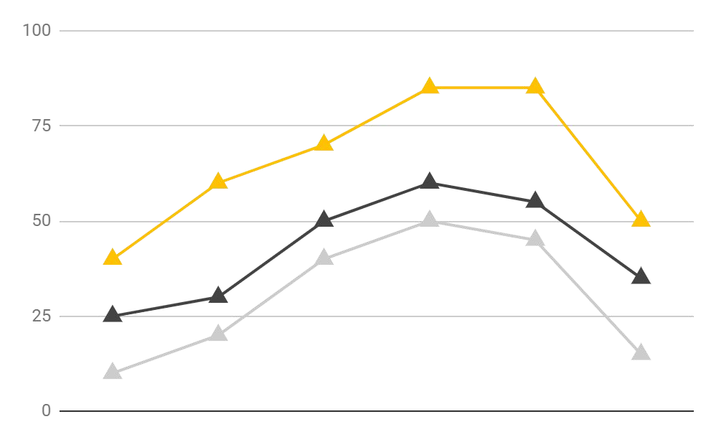
Deployment
Old-Aged
Physically-Challenged
Working Parents
Our product is mainly aimed towards the benefit of old people
It can be scaled up as per the user’s requirement easily.
Our product helps children monitor their aged parents at home. They can monitor them using the app and can make their lives easier.

Slide 14
Bibliography
IoT Smart Home with Intruder Detection
Android Controlled Home Automation by Sabin Adhikari, Sangam KC, Santosh Lamichanne, Urjala Bajracharya, 2017, A report on Home Automation using Android OS
Home Automation using Arduino by Anirban Bhowmik, Sandip Kumar Das,Souvik Acharya,Tusharkanti Murmu 2018 IEEE 5th international conference, 2018

